Slide 1
Group by + apply +lambda
Jake Feldman
Washington University in St. Louis

Slide 2
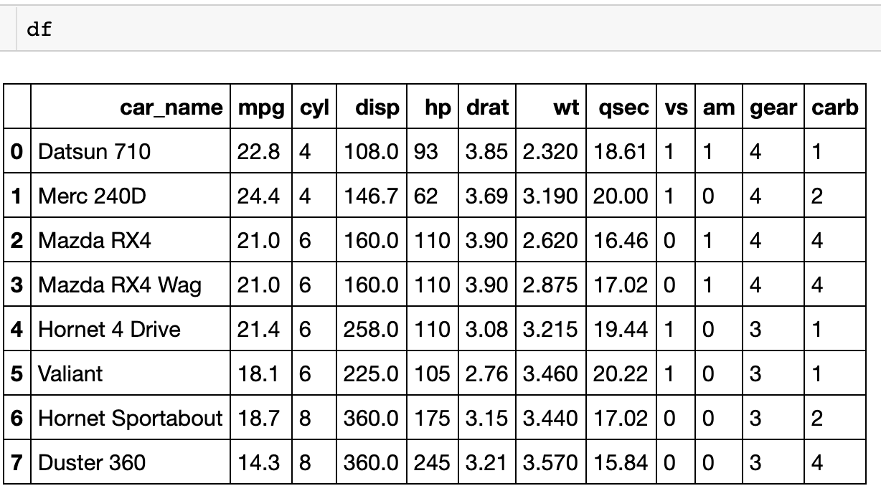
Basic Group By
For each cylinder type what is the average mpg?

Slide 3

Basic Group By
Cyl
4
6
8

Slide 4
Basic Group By
Cyl
4
6
8
What is df?

Slide 5
Basic Group By
df=
Cyl
4
6
8

Slide 6
Basic Group By
df=
Cyl
4
6
8

Slide 7
Basic Group By
df=
Cyl
4
6
8

Slide 8
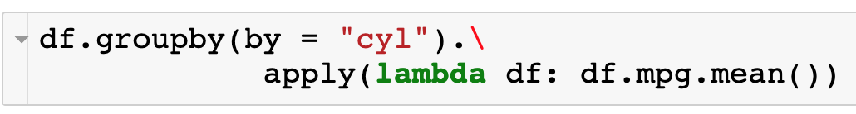
Basic Group By
df=
Cyl
4 – 23.6
6
8

Slide 9
Basic Group By
df=
Cyl
4 – 23.6
6 – 20.375
8

Slide 10
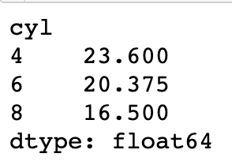
Basic Group By

Slide 11
Basic Group – Return Two Stats
For each cylinder type what is the average mpg and stdev hp?

Slide 12
Basic Group – Return Two Stats
Cyl
mpg hp
4
6
8

Slide 13
Basic Group – Return Two Stats
Cyl
mpg hp
4
6
8
Need to return a row (series) for each group

Slide 14
Basic Group – Return Two Stats
How do I create a row with two entries?
Cyl
mpg hp
4
6
8

Slide 15
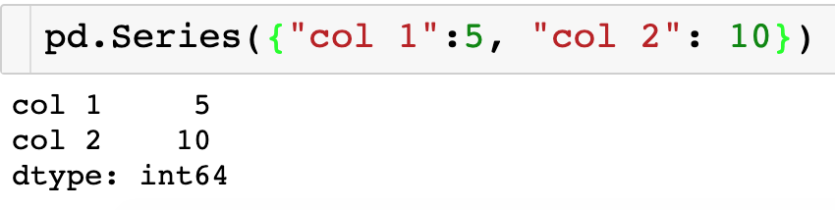
Basic Group – Return Two Stats
How do I create a row with two entries?
Cyl
mpg hp
4
6
8

Slide 16
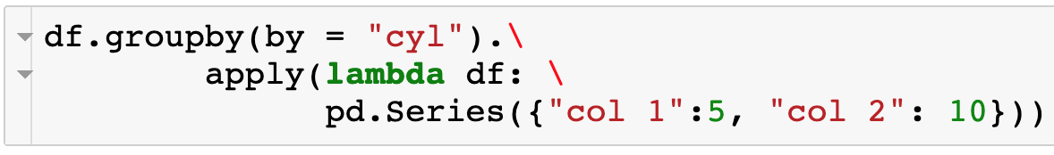
Basic Group – Return Two Stats
Cyl
mpg hp
4
6
8

Slide 17
Basic Group – Return Two Stats
df=
Cyl
col1 col2
4
6
8
5 10

Slide 18
Basic Group – Return Two Stats
df=
Cyl
col1 col2
4
6
8
5 10
5 10

Slide 19
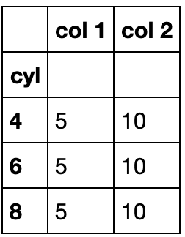
Basic Group – Return Two Stats

Slide 20
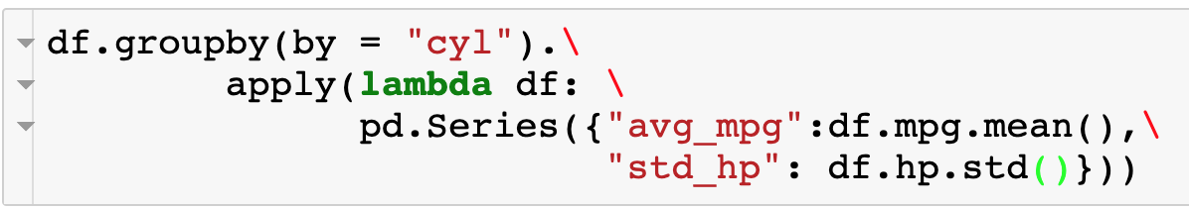
Basic Group – Return Two Stats

Slide 21
Basic Group – Return Two Stats
df=

Slide 22
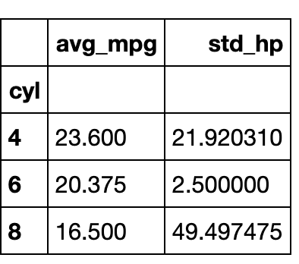
Basic Group – Return Two Stats

Slide 23
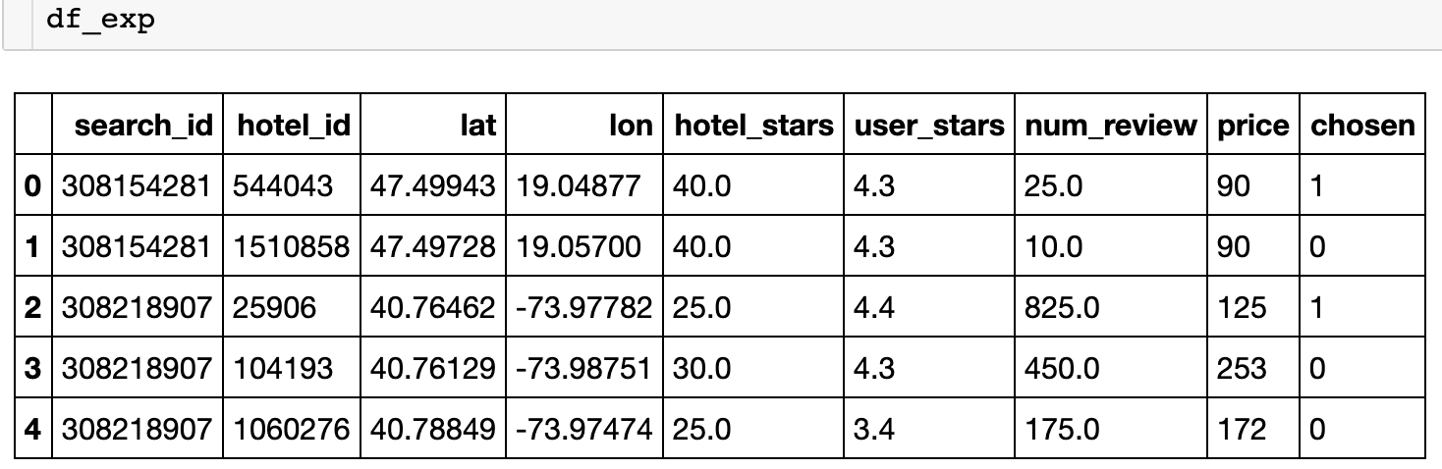
Expedia HW

Slide 24
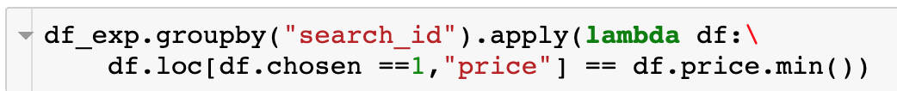
Expedia HW

Slide 25
Expedia HW
Pick out price of chosen option
(this will return a df cause of .loc)
Get the cheapest offered price

Slide 26
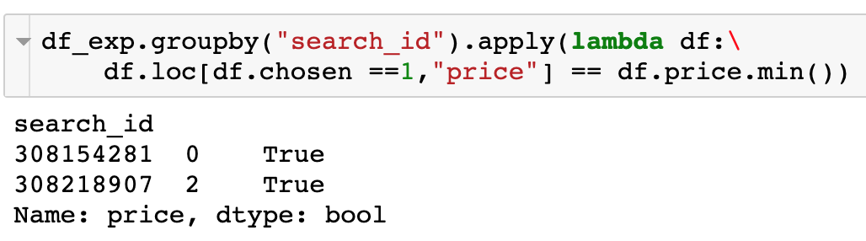
Expedia HW

Slide 27
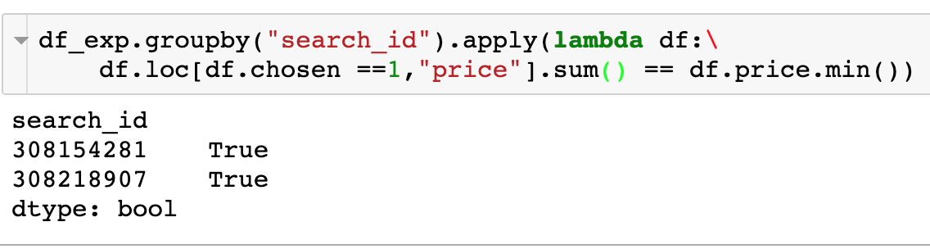
Expedia HW
Now this returns a single number hence == return just boolean

Slide 28
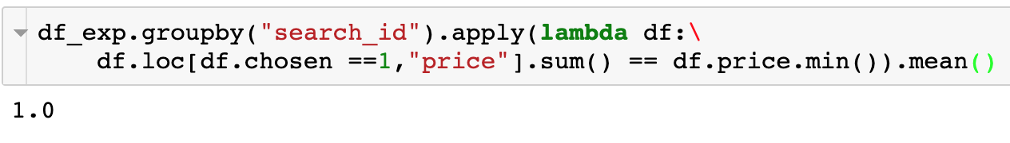
Expedia HW

